Slide 1
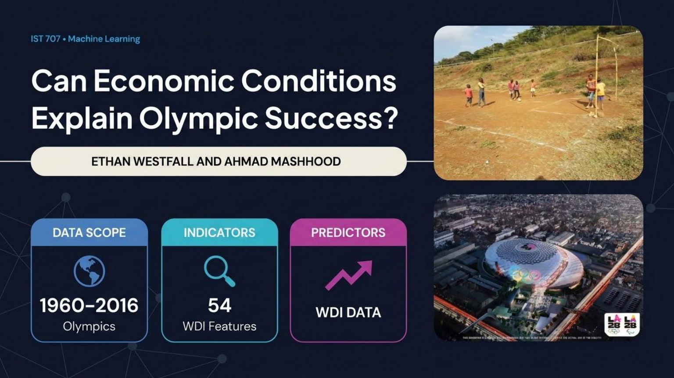

Slide 2
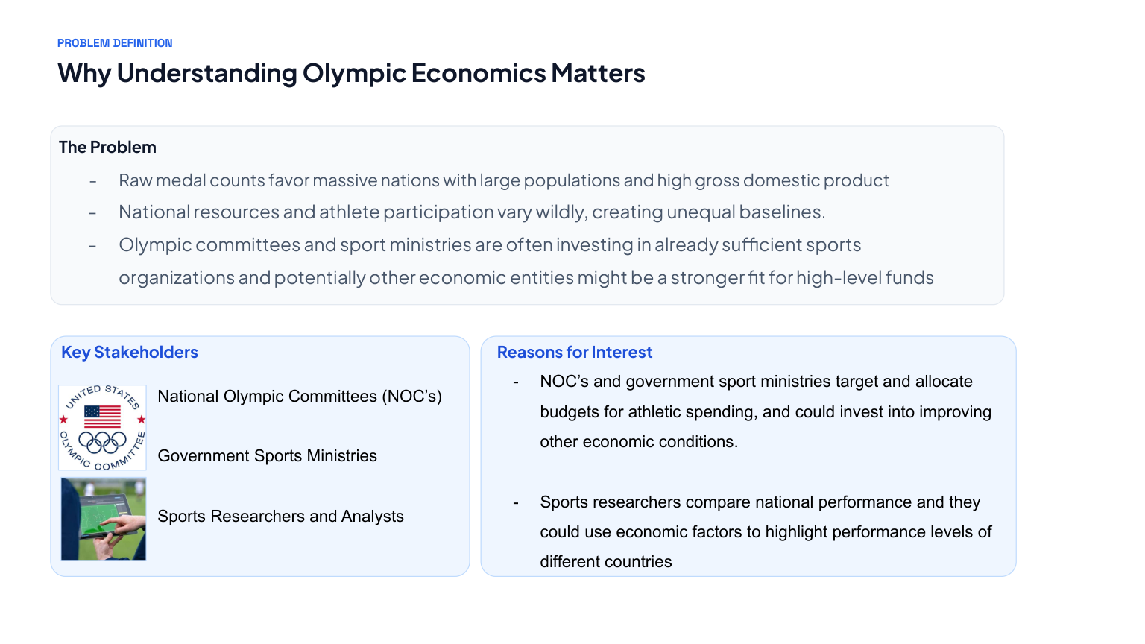

Slide 3
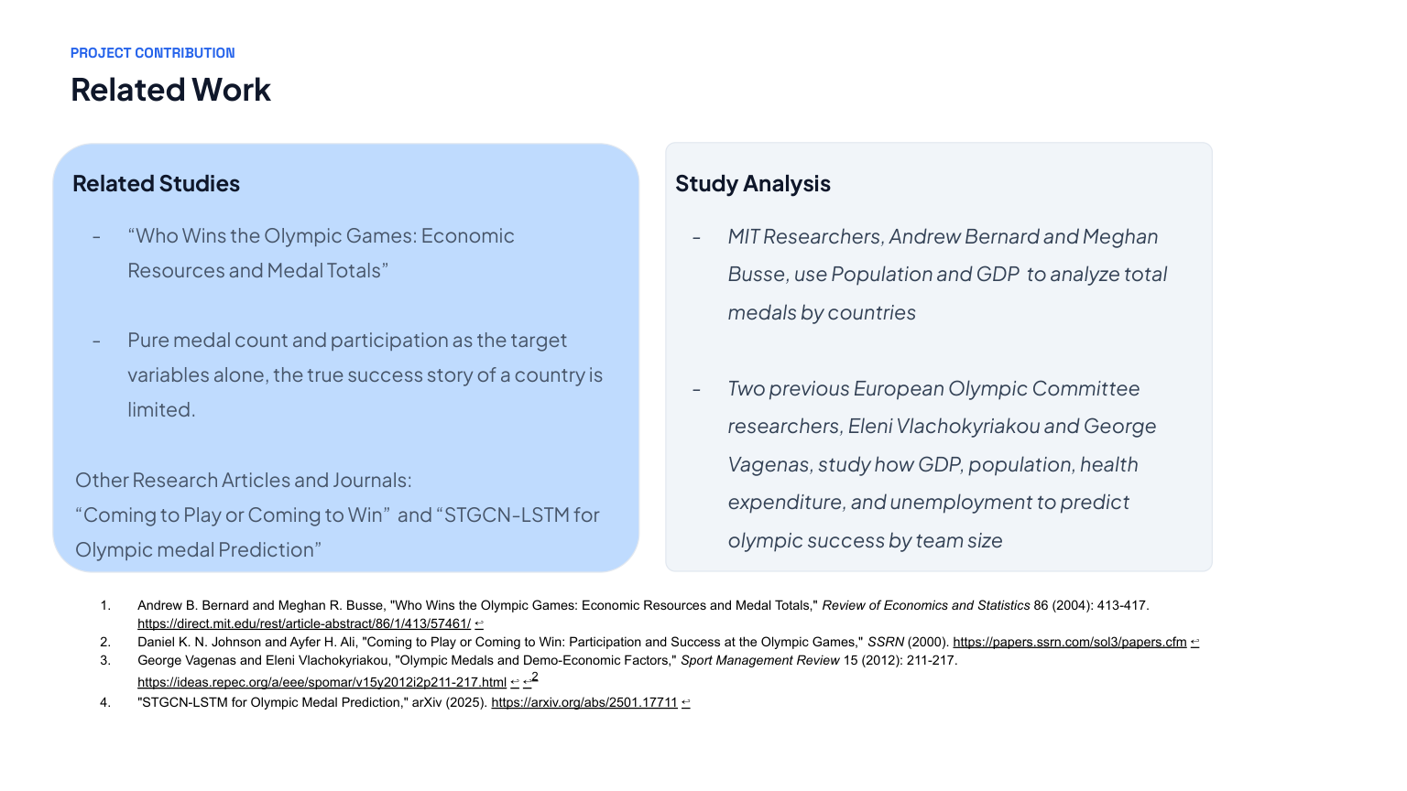

Slide 4
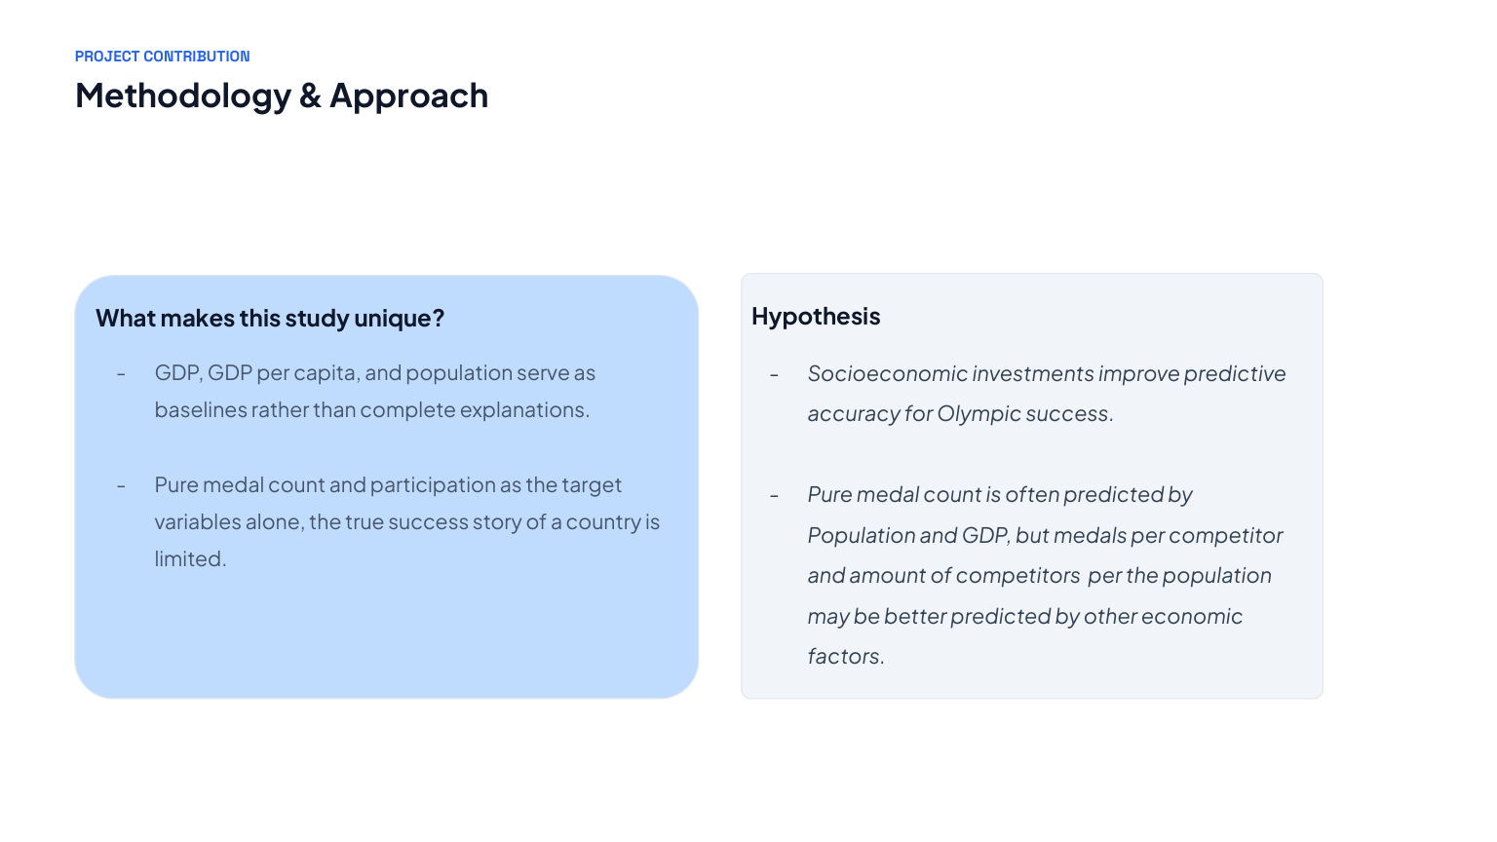

Slide 5
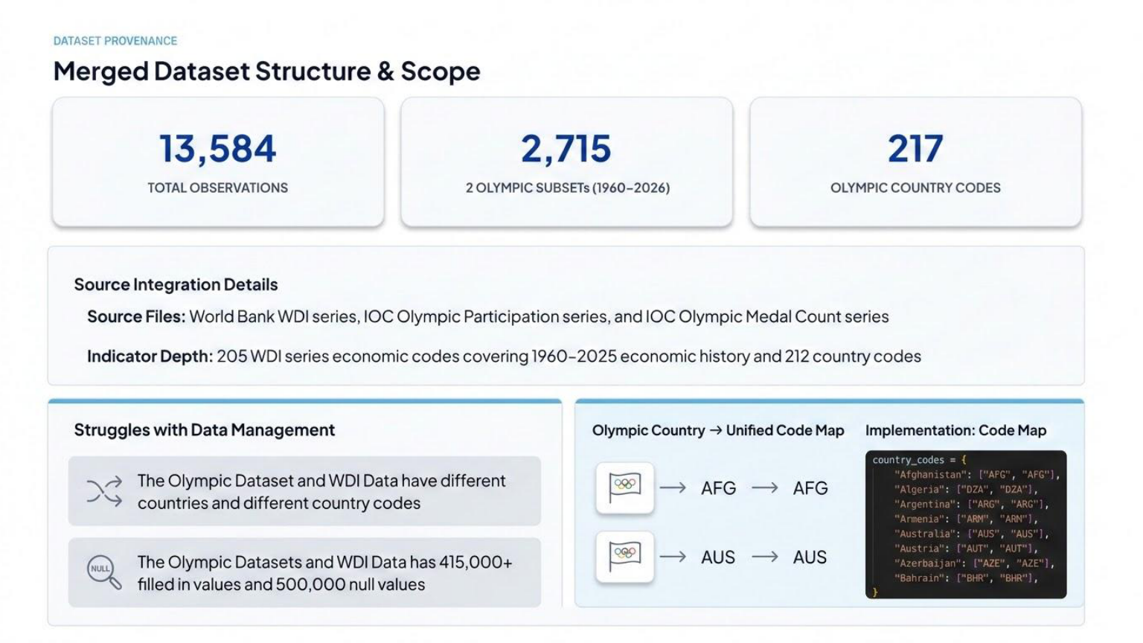

Slide 6
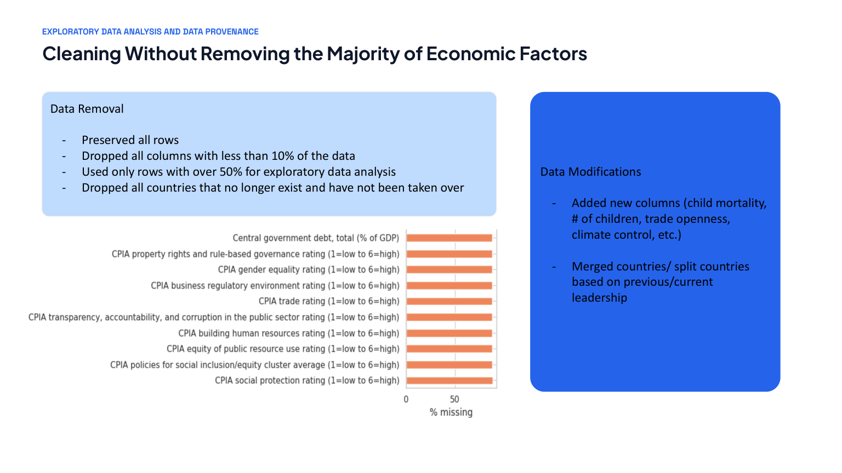

Slide 7
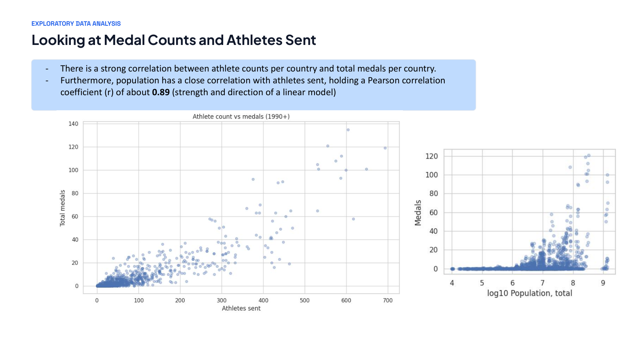

Slide 8
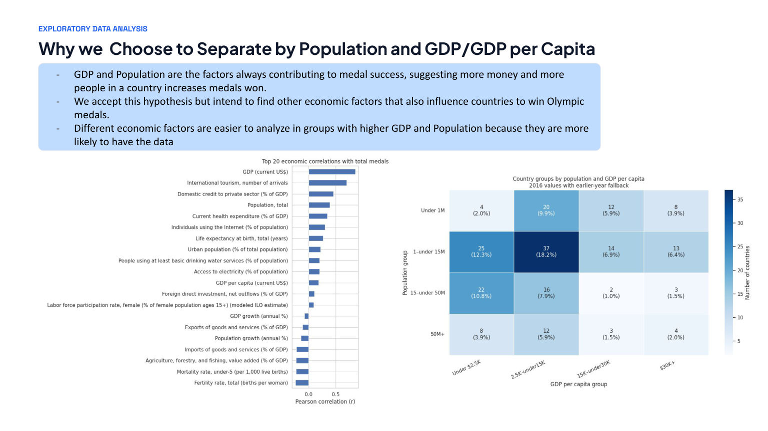

Slide 9
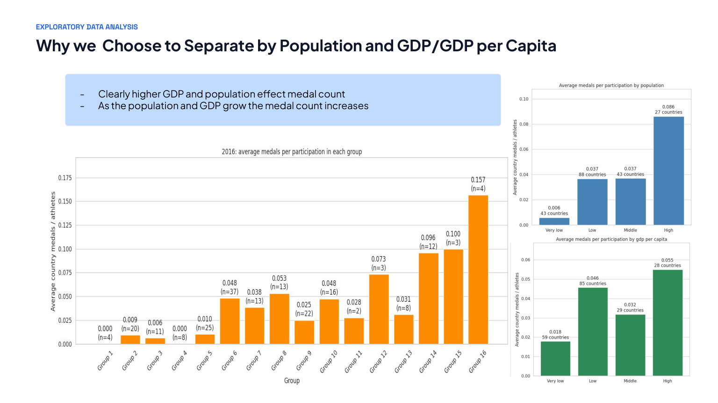

Slide 10
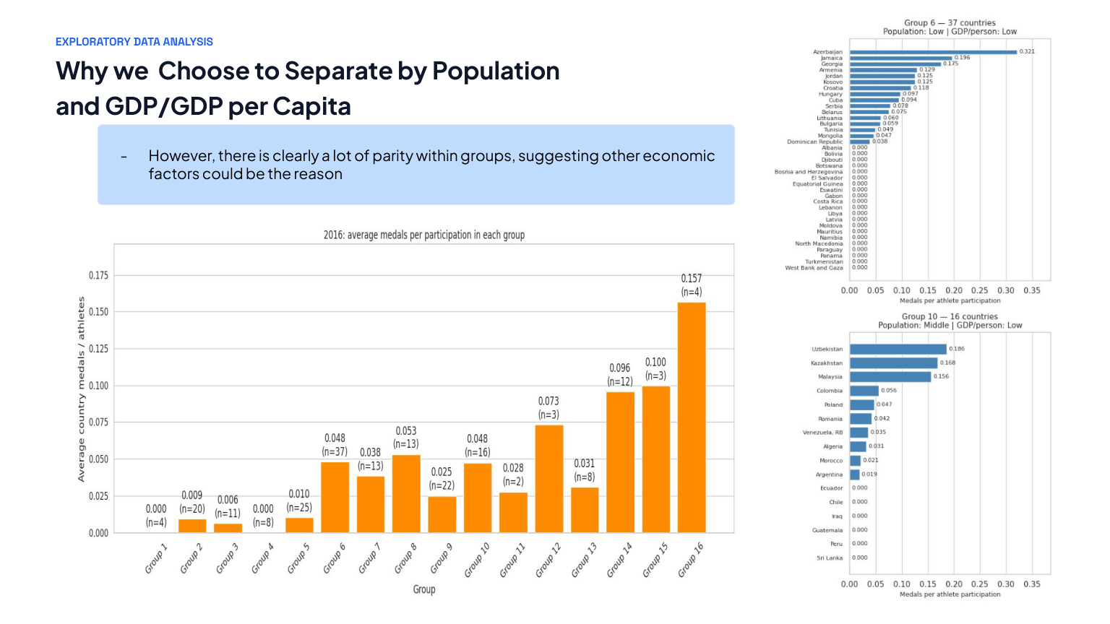

Slide 11
MODEL EVALUATION
What does a null baseline predict?
Null model
Why it matters
The null model predicts the mean of the training sets medal count for every country, regardless of its population, wealth (GDP), athlete participation, health expenditure, etc.
The null model provide a reference for judging whether economic predictors add value to the test model.
We evaluate all models on countries withing the groups and without the groups using the same test-split.
MAE measures the average absolute difference between predicted and actual medals; R² measures improvement in explaining variation.
Null baseline MAE: 6.781 medals | R²: −0.004
Null baseline with Groups MAE: 8.538 | R²: -0.004

Slide 12
MODEL EVALUATION
Adding Economic Predictors Helps Improve on the Null Baseline
Null baseline
6.781
Ridge: all factors
3.708
Null baseline: Grouped
8.538
Ridge: grouped
5.873
Ridge using all economic factors lowers the average prediction error from 6.781 to 3.708 medals—a 45.3% reduction. The grouped model also improves from the baseline model.

Slide 13
MODEL EVALUATION
Comparing our Regression Models
R²
MAE
Null mean
-0.004
6.781
Ridge: all economic factors
0.673
3.708
Random forest
0.481
4.367
Decision tree
0.319
4.181
XGBoost
0.300
4.560
Ridge: grouped, no GDP/population
0.171
5.873
Ridge with all economic factors leads on both metrics (R² = 0.673; MAE = 3.708). The grouped model trails the baseline improvement, suggesting GDP and population contain substantial predictive information.

Slide 14
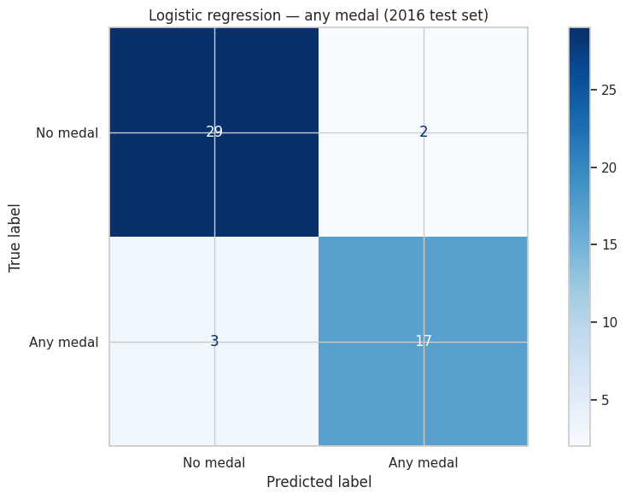
MODEL INTERPRETATION
Actual vs. predicted medal totals
Interpretation
Predictions generally rise as actual medal totals rise, showing that economic conditions capture meaningful differences among countries. This chart represents group 16’s total medals.
However, predictions are less reliable for countries with exceptionally high medal totals and exceptionally low medal totals.

Slide 15
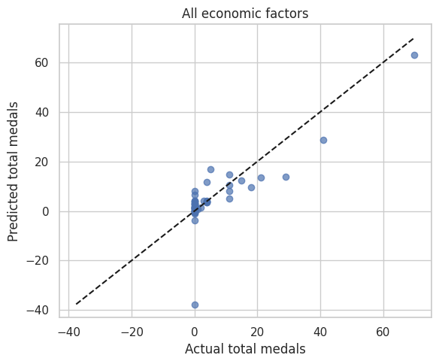
KEY FINDINGS
What did we learn?
Evidence from the models
The all-factor Ridge model performs best on held-out countries (R² = 0.673; MAE = 3.708), beating the mean-only baseline (MAE = 6.781).
The grouped Ridge approach without direct GDP/population predictors is weaker (R² = 0.171; MAE = 5.873). Grouping alone does not recover the predictive information lost by excluding these variables.

Slide 16
LIMITATIONS AND NEXT STEPS
Challenges, future work and implications
Challenges
Next steps
• Missing indicators vary across countries and years, reducing usable training data.
• Medal totals are highly skewed: a small number of countries win many medals.
• GDP and population can overshadow weaker relationships with other indicators.
• Correlations describe associations, not proof that economic policy causes medals.
• Validate across multiple Olympic years to test whether results generalize over time.
• Tune hyperparameters and compare models using consistent cross-validation.
• Analyze medals per athlete alongside total participation per population.
• Examine prediction errors by country size and income group to identify systematic bias.
• Tune grouped models to better analyze individual economic factors within groups

Slide 17
CONCLUSION
Economic conditions help explain Olympic success
Main Takeaway
Economic indicators help predict national Olympic medal totals. Our strongest model—Ridge regression using the full economic feature set—achieves MAE 3.708, compared with 6.781 for a mean-only baseline.
GDP and population are informative, but differences within similarly sized and wealthy country groups suggest that additional factors and sporting context deserve further study.
Questions & Discussion

